Slide 1
CEN TC442/WG4/TG3 SML Property Modelling A proposal for a common linked data approach for CEN & bSI | Michel Böhms

Slide 2
Landscape
ISO TC 59SC 13WG 6
ISO 12006-3:2007
ISO 12006-3:2021 (committee draft: added UML, updated spec, Turtle annex)
CEN TC442/WG4
EN ISO 23386: “International version of French PPBIM”, “set of attributes for properties”, conceptual
EN ISO 23387: ISO 12006-3:2007 “implementation” of “EN ISO 23386”
TG3 Semantic Modelling and Linking (SML) Standard (in enquirey phase)
Including modelling pattern for Quantities inspired by OPM Level 2 & 3
Annex on 12006-3:2021 integration (complementary)
W3C Linked Building
Data (LBD) Community Group
OPM: https://w3c-lbd-cg.github.io/opm/
BOT 0.3.2: https://github.com/w3c-lbd-cg/bot/releases/tag/v0.3.2
RDF-DEV COMMUNITY GROUP
https://w3c.github.io/rdf-star/rdf-star-cg-spec.html
bSI bSDD
https://github.com/buildingSMART/bSDD/tree/master/2020%20prototype
JSON Schema / API (link to 12006-3/23387: unclear, some properties of 23386)
https://github.com/buildingSMART/bSDD/blob/master/2020%20prototype/import-model/bsdd-import-model.json
Hope: One future-proof, ‘Linked Data’-based approach for property modelling !

Slide 3
CEN SML
Scope
Conceptual Meta Model (CMM)
Language-bindings for RDF + (SKOS, RDFS+OWL & RDFS+SHACL)
OPM Level 1-based by default
Identification/URI, naming/labels and annotation conventions
Enumeration Datatypes (smls:EnumerationType)
Decomposition (smls:hasPart)
Quantities
OPM Level 2/3 based (via relations having range smls:QuantityValue)
Quantity kinds & Units > QUDT version 2.1.2
Grouping (SKOS/RDFS-based)
Conceptual Modelling (CM) Patterns
Top Level taxonomy and relations
Linking approaches for both data and ontology level

Slide 4
The SML property proposal
Attribute
Annotation > owl:AnnotationProperty
Quality (non-enumeration) > owl:DatatypeProperty
Quality (enumeration) > owl:ObjectProperty wit rdfs:range (subclass of smls:EnumerationType)
Quantity > owl:ObjectProperty with rdfs:range smls:QuantityValue
Relation > owl:ObjectProperty
Grouping > rdfs:Container, rdfs:member

Slide 5
Smls:QuantityValue (in OWL & Turtle)
smls:QuantityValue
a owl:Class ;
rdfs:subClassOf [
a owl:Restriction ;
owl:allValuesFrom xsd:float ;
owl:onProperty rdf:value ;
] ;
rdfs:subClassOf [
a owl:Restriction ;
owl:cardinality "1"^^xsd:nonNegativeInteger ;
owl:onProperty rdf:value ;
] ;
skos:prefLabel “Quantity value"@en .

Slide 6
Example (graphical)
ex:clear
Opening
Height
owl:Object
Property
rdfs:subPropertyOf
rdf:type
rdfs:domain
quantity
Kind:
Length
smls:quantityKind
ex:height
smls:
Quantity
Value
rdfs:range
“OWL2 Punning”
ex:Door
rdf:type
(derived)
Implicit
in RDF
unit:M
rdf:type
ex:Door_1
_:height1
smls:unit
ex:height
rdf:value
2.40
“blank node”

Slide 7
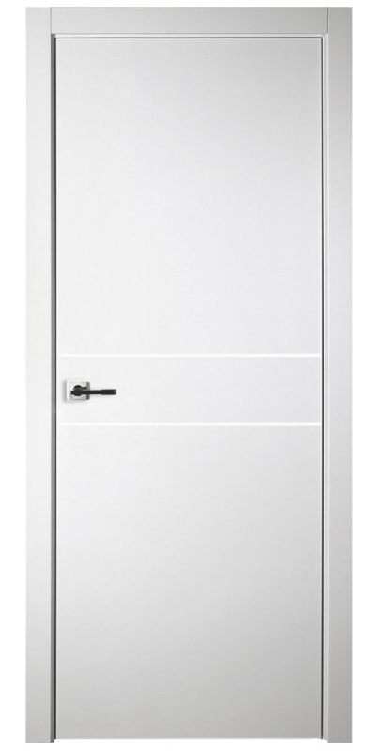
Example (OWL / Turtle)
ex:Door a owl:Class .
ex:height a owl:ObjectProperty ;
rdfs:range smls:QuantityValue ;
smls:quantityKind quantitykind:Length .
ex:clearOpeningHeight a owl:ObjectProperty ;
skos:definition “height measured from top threshold to bottom of stop”@en ;
rdfs:subPropertyOf ex:height ;
rdfs:domain ex:Door ;
rdfs:seeAlso "EN12519" ; -- example external reference
pdt:languageCode nace:FR ; -- example CEN PDT meta-data
pdt:dateOfVersion “2019-11-06T16:10” . -- example CEN PDT meta-data
ex:Door_1 a ex:Door ;
ex:clearOpeningHeight [rdf:value 2.40 ;
smls:unit unit:M ;
ex:hasAccuracy 85.5 ;
ex:measuredBy “Somebody" ; ] .
ex:PropertyDefSet_1 a rdfs:Container ;
rdfs:member ex:clearOpeningHeight .
In bold: some more data added

Slide 8
Constraints on & derivations from those properties
Best done in SHACL Core/AF (utilizing property paths, sh:value etc.!)
In OWL, options
PropertyChains
Intersection
Subclassing smls:QuantityValue
Or:
Model explicitly

Slide 9

Future Simplification in RDF*/Turtle*
ex:Door a owl:Class .
ex:height a owl:ObjectProperty {| smls:quantityKind quantitykind:Length |} .
ex:height rdfs:range smls:QuantityValue .
ex:clearOpeningHeight a owl:ObjectProperty {| pdt:languageCode nace:FR ;
pdt:dateOfVersion “2019-11-06T16:10” |}.
ex:clearOpeningHeight
skos:definition “height measured from top threshold to bottom of stop”@en ;
rdfs:seeAlso "EN12519" ;
rdfs:subPropertyOf ex:height ;
rdfs:domain ex:Door .
ex:Door_1 a ex:Door ;
ex:clearOpeningHeight 2.40 {| smls:unit unit:M ;
ex:hasAccuracy 85.5 ;
ex:measuredBy “Somebody" |}.
smls:
Quantity
Value

Slide 10
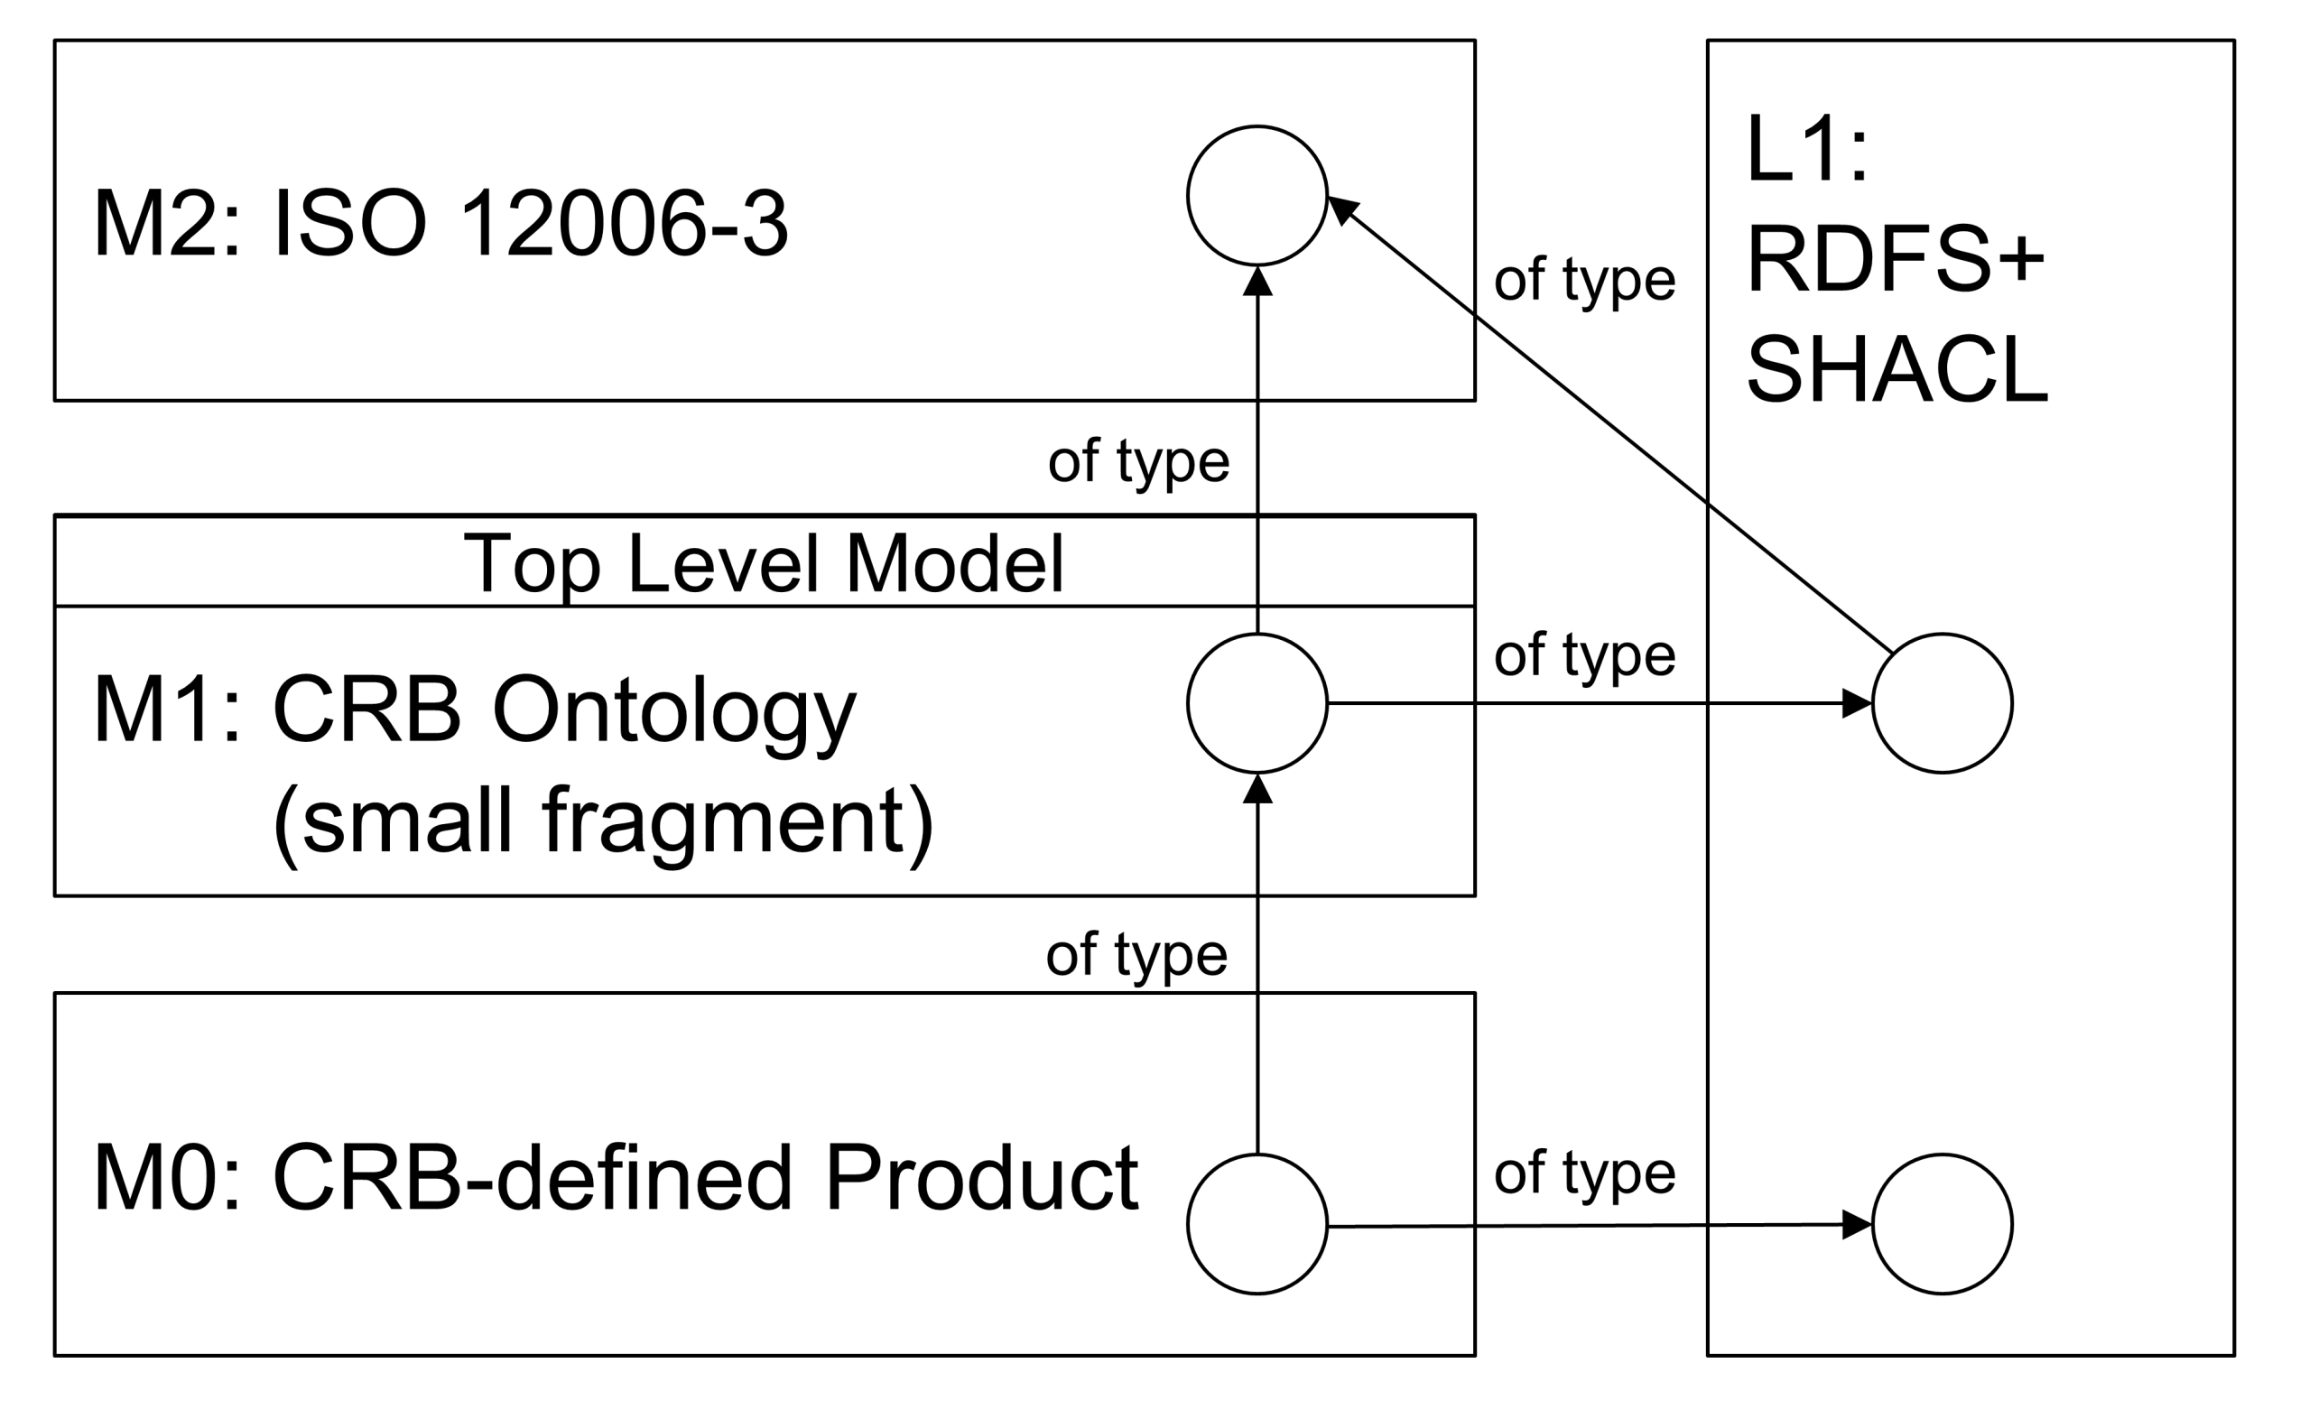
Combining 12006-3 & SML
2012 update
or RDFS+OWL
as in 12006-3:2021 CD
(not compliant to SML yet!)
Separate or as
part of bSDD

Slide 11
Current bSI bSDD: JSON (Swagger API/Graph-QL)
{
"OrganizationCode": "",
"DomainCode": "",
"DomainVersion": "",
"DomainName": "",
"ReleaseDate": null,
"Status": "",
"MoreInfoUrl": "",
"UseOwnUri": false,
"DomainNamespaceUri": "",
"LanguageIsoCode": "",
"LanguageOnly": false,
"License": "",
"LicenseUrl": "",
"QualityAssuranceProcedure": "",
"QualityAssuranceProcedureUrl": "",
"Classifications": [{
"Code": "",
"OwnedUri": "",
"Name": "",
"Definition": "",
"Status": "Active",
"ActivationDateUtc": "2020-12-09T00:00:00+01:00",
"RevisionDateUtc": null,
"VersionDateUtc": "2020-12-09T00:00:00+01:00",
"DeActivationDateUtc": null,
"VersionNumber": null,
"RevisionNumber": null,
"ReplacedObjectCodes": [],
"ReplacingObjectCodes": [],
"DeprecationExplanation": "",
"CreatorLanguageIsoCode": "",
"VisualRepresentationUri": "",
"CountriesOfUse": [],
"SubdivisionsOfUse": [],
"CountryOfOrigin": "",
"DocumentReference": "",
"ClassificationType": "Class",
"ParentClassificationCode": "",
"RelatedIfcEntityNamesList": [],
"Synonyms": [],
"ClassificationRelations": [{
"RelationType": "",
"RelatedClassificationUri": ""
}],
"ClassificationProperties": [{
"Code": "",
"PropertyCode": "",
"PropertySet": "",
"ExternalPropertyUri": "",
"Unit": "",
"SortNumber": null,
"Symbol": "",
"PropertyType": "",
"PredefinedValue": "",
"MinInclusive": null,
"MaxInclusive": null,
"MinExclusive": null,
"MaxExclusive": null,
"Pattern": "",
"Values": []
}]
}],
"Properties": [{
"Code": "",
"OwnedUri": "",
"Name": "",
"Definition": "",
"Status": "Active",
"ActivationDateUtc": "2020-12-09T00:00:00+01:00",
"RevisionDateUtc": null,
"VersionDateUtc": "2020-12-09T00:00:00+01:00",
"DeActivationDateUtc": null,
"VersionNumber": null,
"RevisionNumber": null,
"ReplacedObjectCodes": [],
"ReplacingObjectCodes": [],
"DeprecationExplanation": "",
"CreatorLanguageIsoCode": "",
"VisualRepresentationUri": "",
"CountriesOfUse": [],
"SubdivisionsOfUse": [],
"CountryOfOrigin": "",
"DocumentReference": "",
"Description": "",
"Example": "",
"ConnectedPropertyCodes": [],
"PhysicalQuantity": "",
"Dimension": "",
"DimensionLength": null,
"DimensionMass": null,
"DimensionTime": null,
"DimensionElectricCurrent": null,
"DimensionThermodynamicTemperature": null,
"DimensionAmountOfSubstance": null,
"DimensionLuminousIntensity": null,
"MethodOfMeasurement": "",
"DataType": "",
"MinInclusive": null,
"MaxInclusive": null,
"MinExclusive": null,
"MaxExclusive": null,
"Pattern": "",
"IsDynamic": false,
"DynamicParameterPropertyCodes": [],
"Units": [],
"PossibleValues": [],
"TextFormat": ""
}]
}

Slide 12
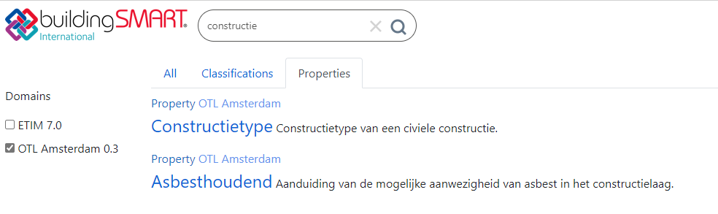
Example
adam-p:constructietype a owl:ObjectProperty ;
skos:definition "Constructietype van een civiele
constructie."@nl ;
skos:prefLabel "Constructietype"@nl ;
skos:related imborp:P676 .
City of Amsterdam Ontology (OTL)
“otl-0.31_Civiele_constructies.ttl”
CEN SML compliant
Send to bSI for bSDD (prototype):
Nice, but many conversion issues towards simpler JSON!

Slide 13
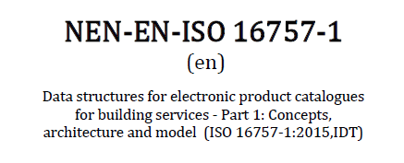
issues
(Even) more reuse of QUDT, beyond quantity kinds and units, like for smls:quantityKind & smls:unit
Harmonize / align with current 12006-3 / bSI approach!?
Now: how to deal with more complex/structured/technical properties?
Big (sensor) data properties (spacetime series)
Geometries
Dependent properties
>>> Richard Pinka

Slide 14
Thank you for your attention
Take a look:
TNO.NL/TNO-INSIGHTS

